Slide 1
GENERATING AND PROVIDING AUGMENTED REALITY REPRESENTATIONS OF RECOMMENDED PRODUCTS BASED ON STYLE COMPATIBILITY AND STYLE SIMILARITY IN RELATION TO REAL-WORLD SURROUNDINGS
Kumar Ayush | Senior Member of Technical Staff

Slide 2
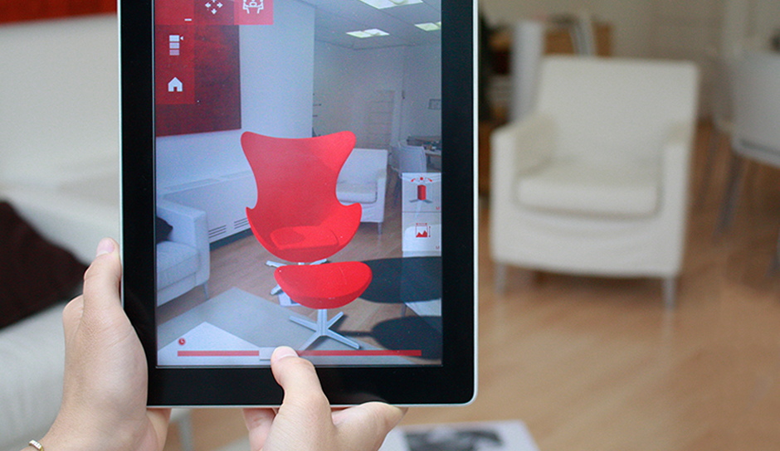
Motivation
A sofa
Objects influencing user’s purchase
A cushioned chair
A carpet
A white wall
User’s color preferences
A red painting
Trying a red chair

Slide 3
Problem Statement
Generating And Providing Augmented Reality Representations of Recommended Products Based on
Style Compatibility
Style Similarity
in relation to Real-World Surroundings

Slide 4
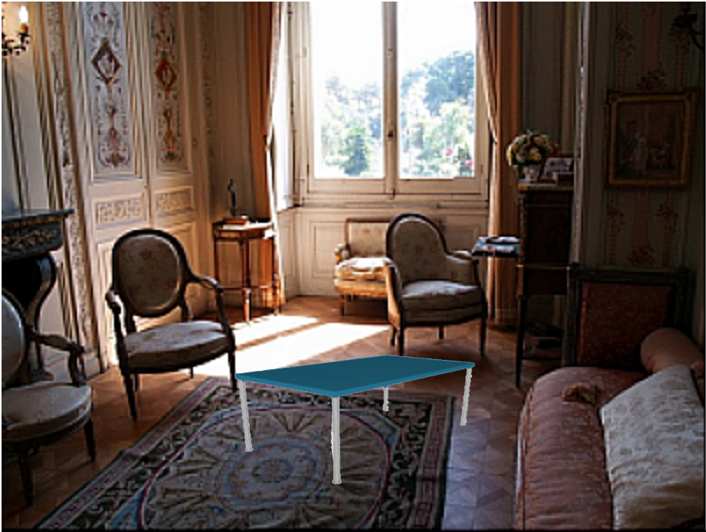
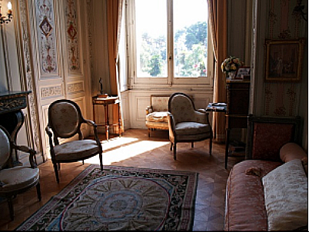
PART I - Recommending Products Based on STYLE COMPATIBILITY in relation to Real-World Surroundings
Step 1: Viewpoint Selection
Screenshot of AR app session (the coffee table is virtual)
Corresponding Camera frame of Viewpoint

Slide 5
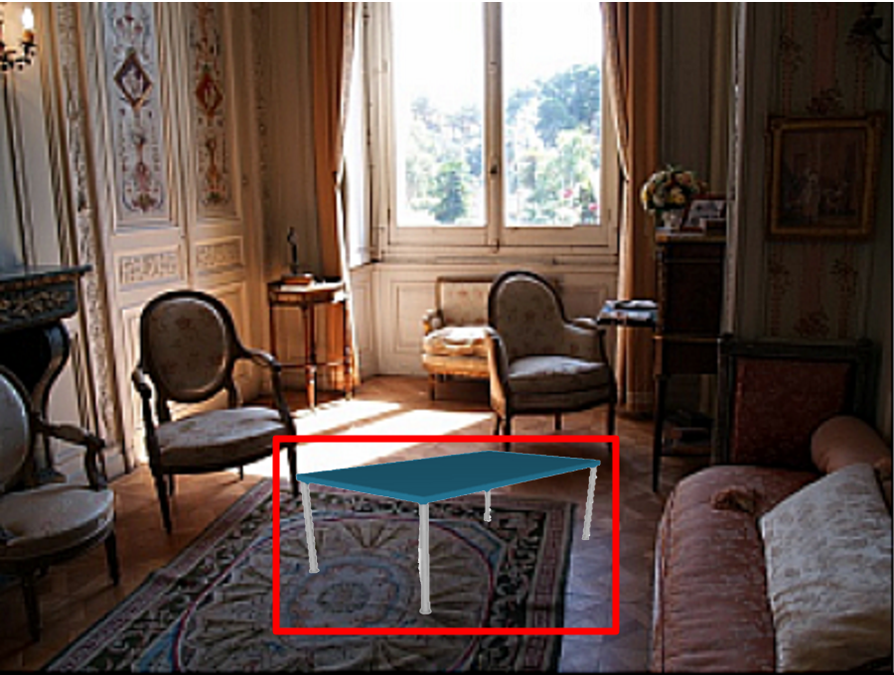
PART I - Recommending Products Based on STYLE COMPATIBILITY in relation to Real-World Surroundings
Step 2: Location and Pose Identification of the Augmented Product being tried by the user
Reference: Naresh Boddeti, Vishnu, Takeo Kanade, and B. V. K. Vijaya Kumar. "Correlation filters for object alignment." Proceedings of the IEEE Conference on Computer Vision and Pattern Recognition. 2013.

Slide 6
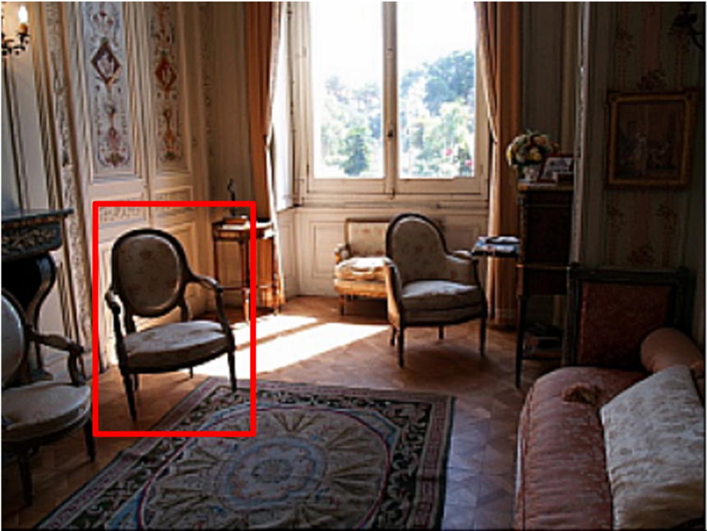
PART I - Recommending Products Based on STYLE COMPATIBILITY in relation to Real-World Surroundings
Step 3: Object Identification
Camera frame of the viewpoint (identified chair is bounded in a red box)
Reference: Shaoqing Ren, Kaiming He, Ross Girshick, Jian Sun. Faster R-CNN: Towards Real-Time Object Detection with Region Proposal Networks. Advances in Neural Information Processing Sytems (NIPS), 2015

Slide 7
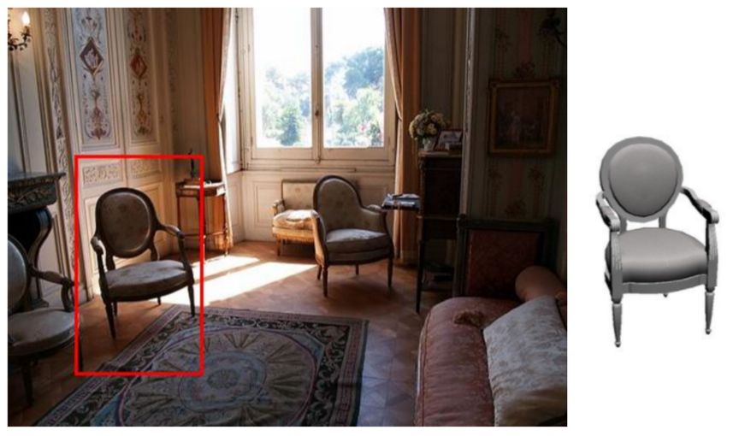
PART I - Recommending Products Based on STYLE COMPATIBILITY in relation to Real-World Surroundings
Step 4: Finding the Best matching 3D model of an identified 2D object
Best matching 3D model of the identified object
Reference: M. Aubry, D. Maturana, A. Efros, B. Russell and J. Sivic. “Seeing 3D chairs: exemplar part-based 2D-3D alignment using a large dataset of CAD models”. CVPR, 2014.

Slide 8
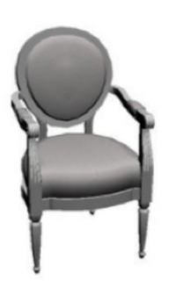
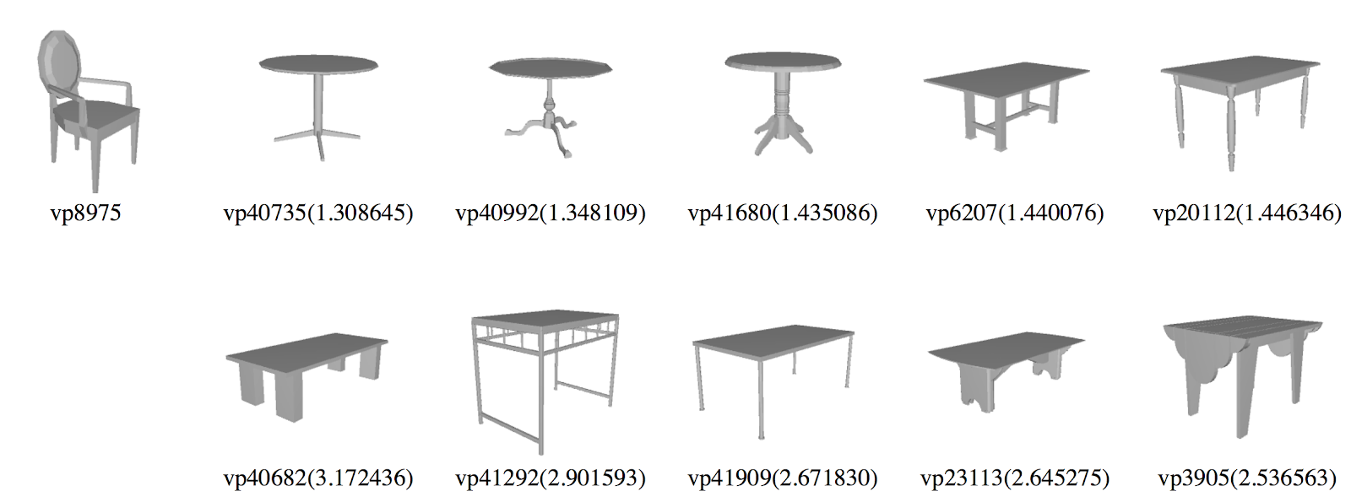
PART I - Recommending Products Based on STYLE COMPATIBILITY in relation to Real-World Surroundings
Step 5: Style Compatibility
Candidates based on style compatibility with the identified object in the Viewpoint
Reference: Tianqiang Liu, Aaron Hertzmann, Wilmot Li and Thomas Funkhouser. “Style Compatibility for 3D Furniture Models”. ACM Transactions on Graphics, August 2015.

Slide 9
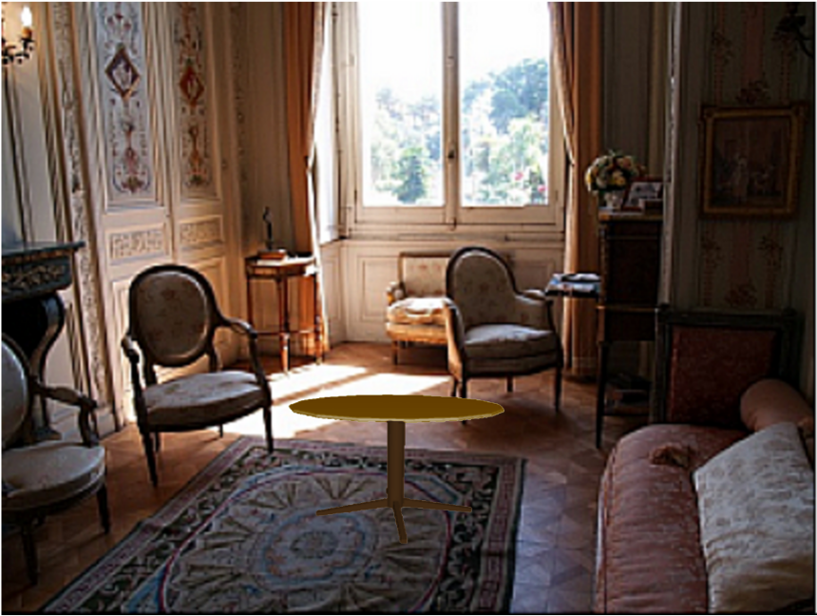
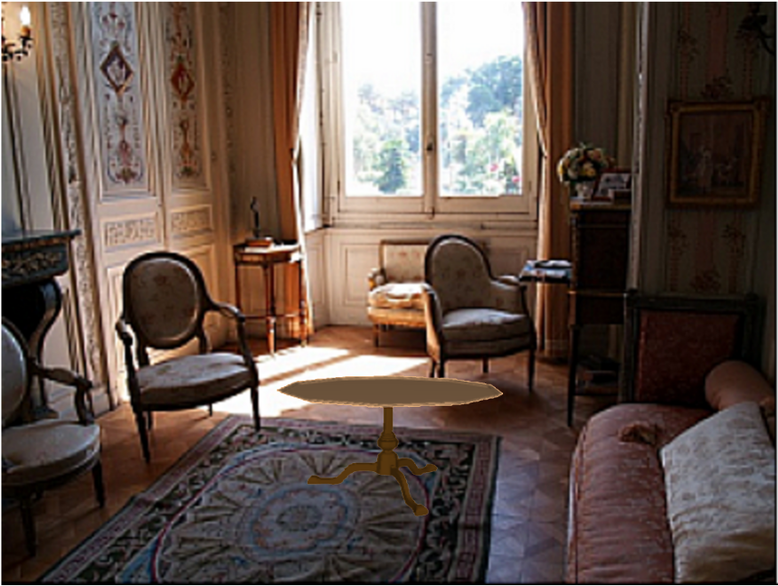
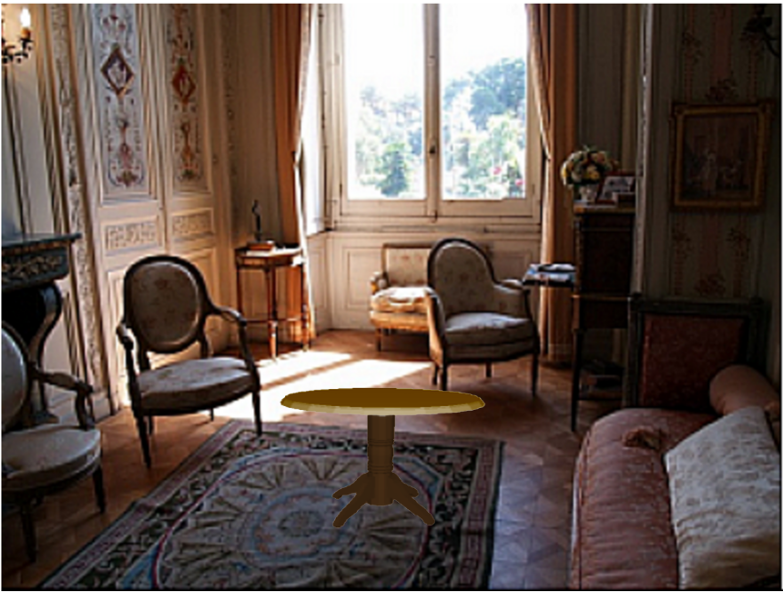
PART I - Recommending Products Based on STYLE COMPATIBILITY in relation to Real-World Surroundings
Step 6: Embedding Candidates in the Viewpoint and Color Compatibility based Texture Selection
Candidates embedded in the Viewpoint at the location and orientation of the initial augmented object.
Product Texture Selection based on Color Compatibility with the Viewpoint.
Reference: Peter O'Donovan, Aseem Agarwala, Aaron Hertzmann, ”Color Compatibility From Large Datasets” , ACM Transactions on Graphics, 2011, 30, 43, (Proc. SIGGRAPH).

Slide 10
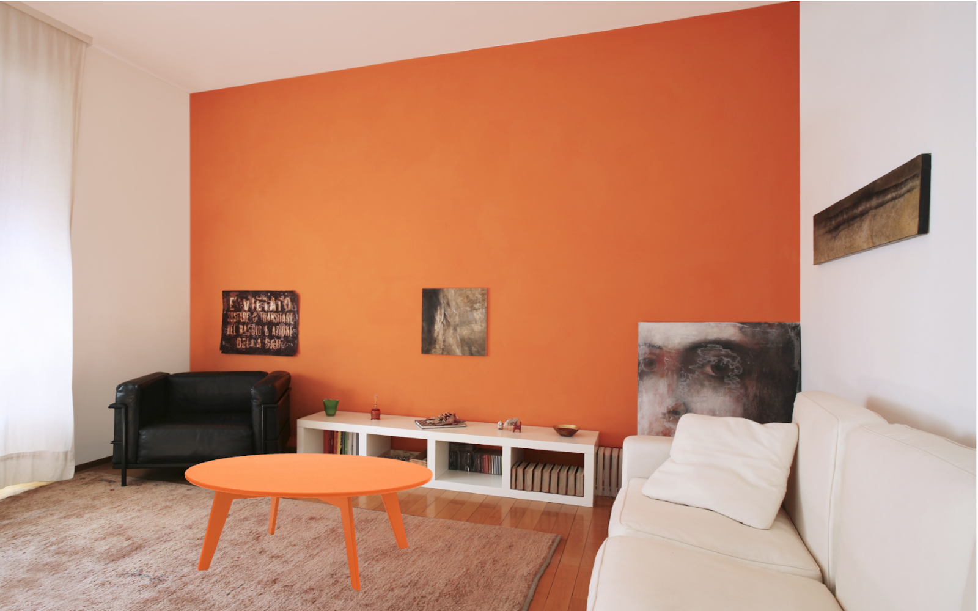
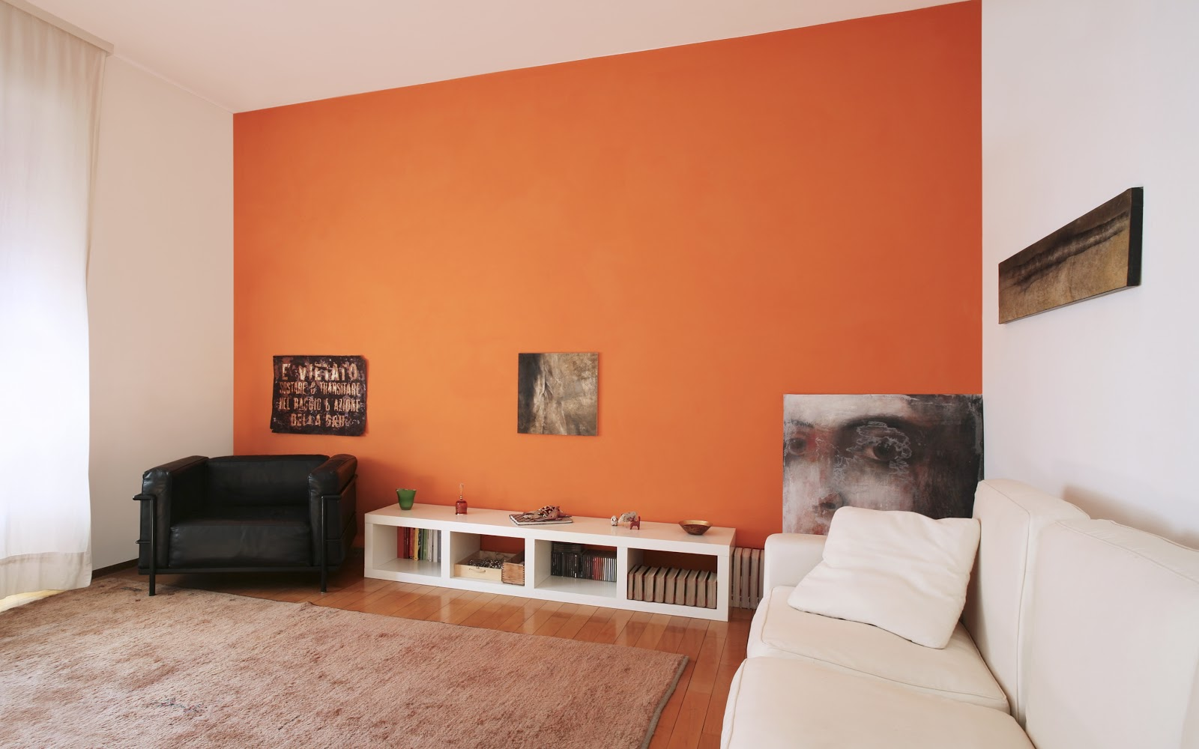
PART II - Recommending Products Based on STYLE SIMILARITY in relation to Real-World Surroundings
Step 1: Viewpoint Selection
Screenshot of AR app session
(orange coffee table is virtual)
Camera frame of viewpoint

Slide 11
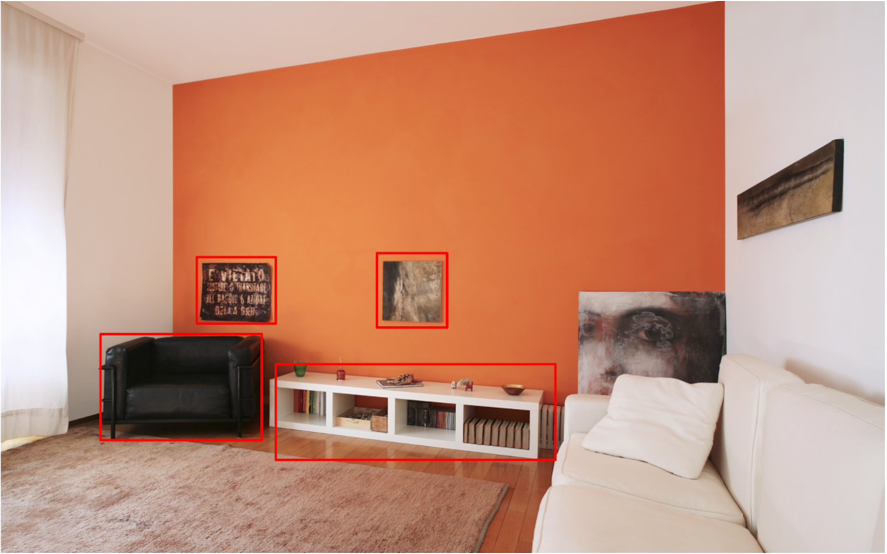
PART II - Recommending Products Based on STYLE SIMILARITY in relation to Real-World Surroundings
Step 2: Object Identification
Obtained bounding boxes corresponding to Different Objects in Camera Frame of Viewpoint

Slide 12
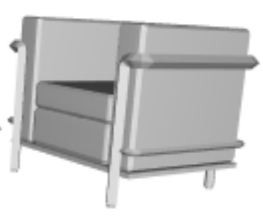
PART II - Recommending Products Based on STYLE SIMILARITY in relation to Real-World Surroundings
Step 3: Alignment of best matching 3D model with an identified 2D object
Given an input image (left), the algorithm searches a database of 3D chair models to detect any depicted chairs in the image.
The algorithm returns a 3D model matching the style of the chair and recovers its pose and scale.
Reference: M. Aubry, D. Maturana, A. Efros, B. Russell and J. Sivic. “Seeing 3D chairs: exemplar part-based 2D-3D alignment using a large dataset of CAD models”. CVPR, 2014.

Slide 13
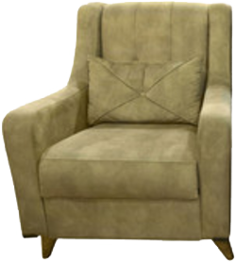
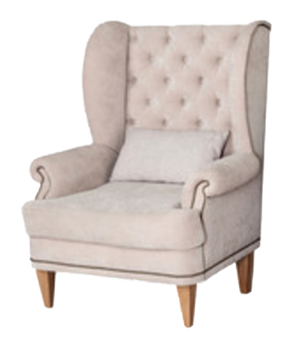
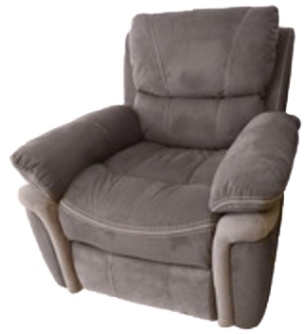
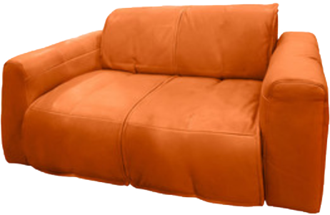
PART II - Recommending Products Based on STYLE SIMILARITY in relation to Real-World Surroundings
Step 4: Style Similarity
Best matching model of the identified black armchair in the viewpoint
Some of the candidate models
Distance between identified object and product model $= D(model_{identified object}, model_{reco.}$)
Reference: Zhaoliang Lun, Evangelos Kalogerakis, Alla Sheffer, "Elements of Style: Learning Perceptual Shape Style Similarity", ACM Transactions on Graphics (Proc. ACM SIGGRAPH 2015)

Slide 14
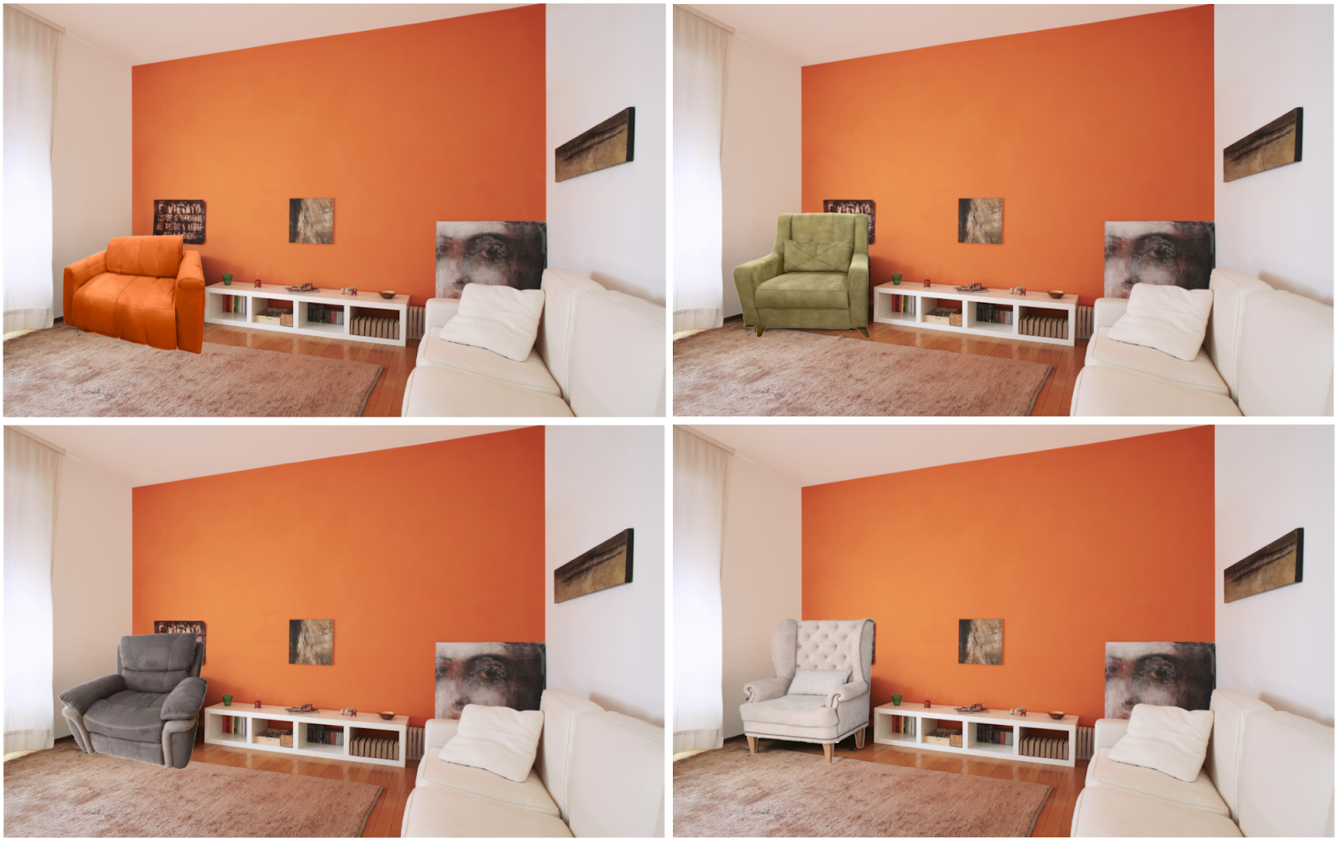
PART II - Recommending Products Based on STYLE SIMILARITY in relation to Real-World Surroundings
Step 5: Context Aware Removal of Identified Objects and Embedding Similar Recommendations
Some of the embedded images

Slide 15
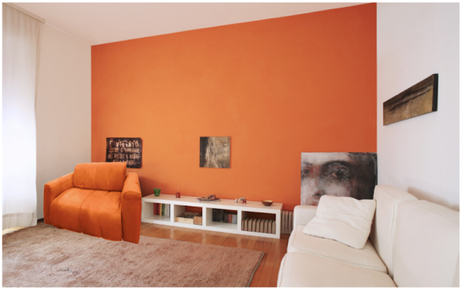

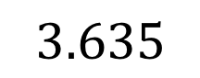
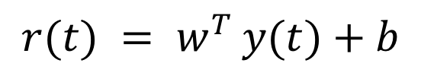
PART II - Recommending Products Based on STYLE SIMILARITY in relation to Real-World Surroundings
Step 6: Color Compatibility
$$3.635$$
$$r(t) = w^{T }y(t)+b$$
Reference: Peter O'Donovan, Aseem Agarwala, Aaron Hertzmann, ”Color Compatibility From Large Datasets” , ACM Transactions on Graphics, 2011, 30, 43, (Proc. SIGGRAPH).

Slide 16
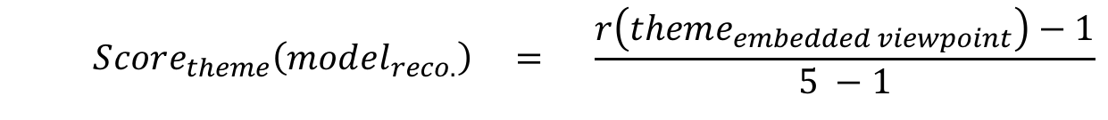
PART II - Recommending Products Based on STYLE SIMILARITY in relation to Real-World Surroundings
Step 7: Overall Score
$$Score_{style similarity}\left(model_{reco.}\right) = \frac{1}{1+D(model_{identified obj.}, model_{reco.})}$$
$$Score_{theme}\left(model_{reco.}\right) = \frac{r\left(theme_{embedded viewpoint}\right)−1}{5 −1}$$
$Score_{overall}\left(model_{reco.}\right) ={ w}_{style}∗Score_{style} +{ w}_{theme}∗$ $Score_{theme}$

Slide 17
PART II - Recommending Products Based on STYLE SIMILARITY in relation to Real-World Surroundings
Step 7: Overall Score
Ranking SVM is used to find $w_{style}$ and $w_{theme}$
After conducting an internal survey to get a ground truth, we got $w_{style}$ = 0.21 and $w_{theme}$ = 1.65
Reference: T. Joachims, ”Optimizing Search Engines Using Clickthrough Data”, Proceedings of the ACM Conference on Knowledge Discovery and Data Mining (KDD), ACM, 2002.

Slide 18
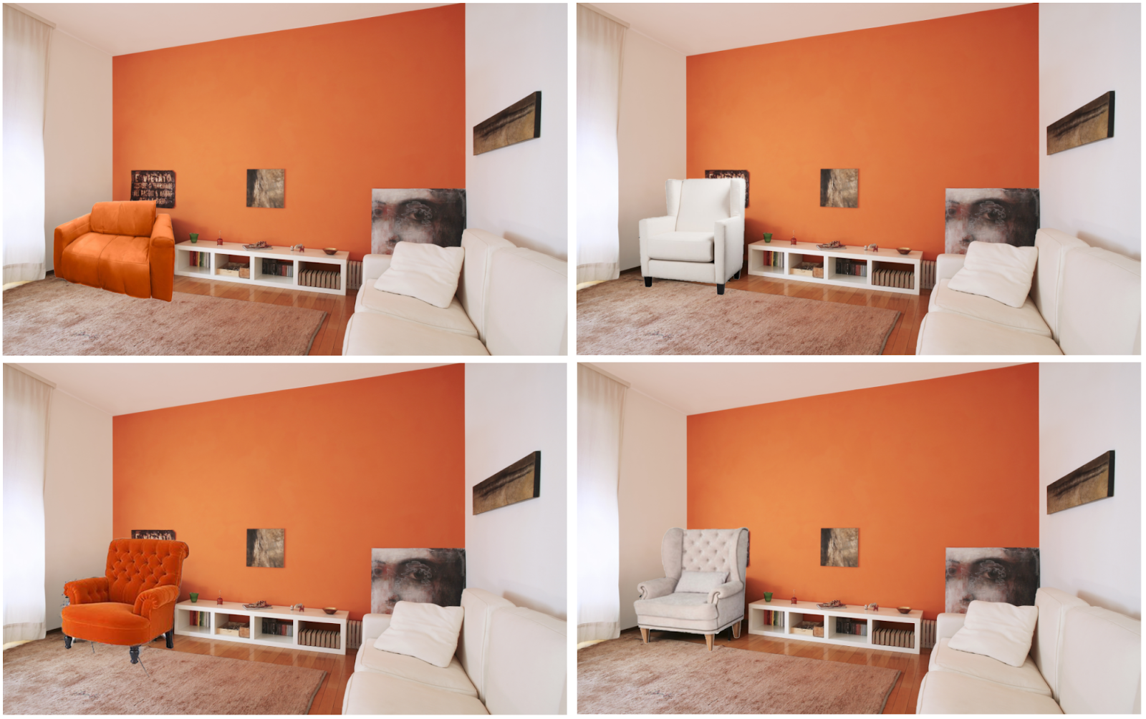
PART II - Recommending Products Based on STYLE SIMILARITY in relation to Real-World Surroundings
Step 8: Final Recommendations
Final Recommendations

Slide 19
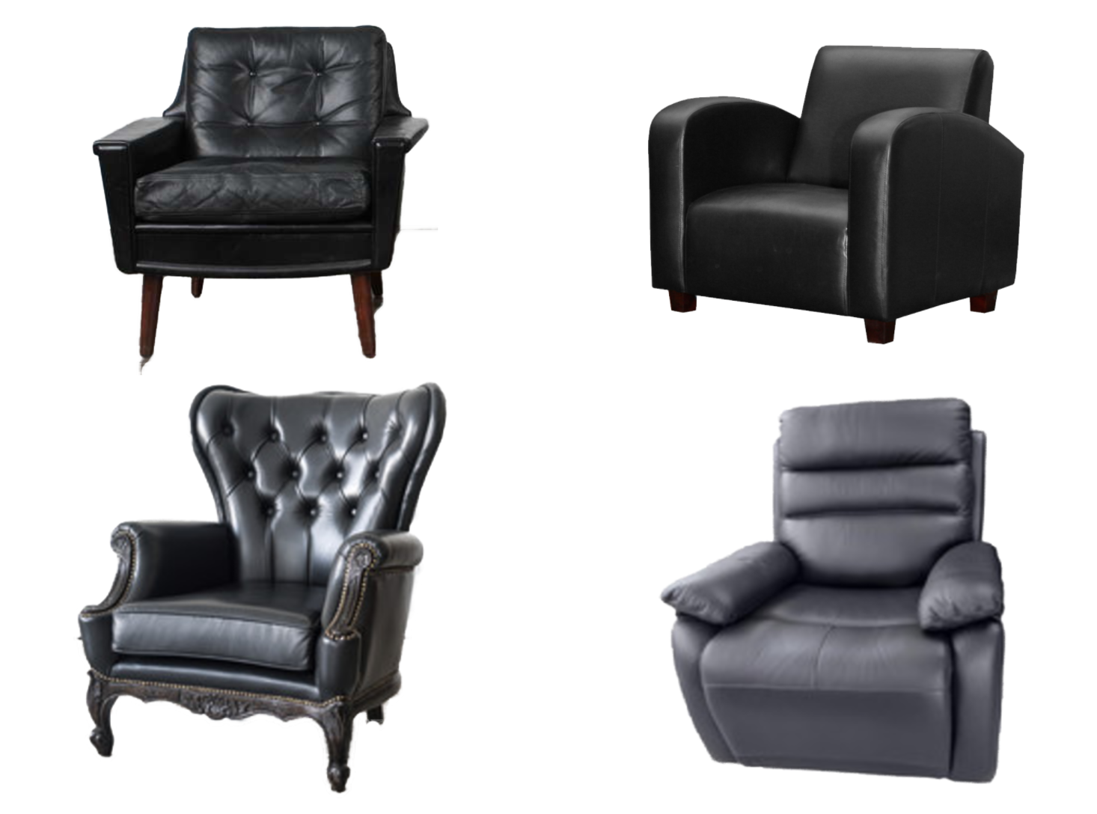
PART II - Recommending Products Based on STYLE SIMILARITY in relation to Real-World Surroundings
Comparison with Baseline Model
Baseline recommendations

Slide 20
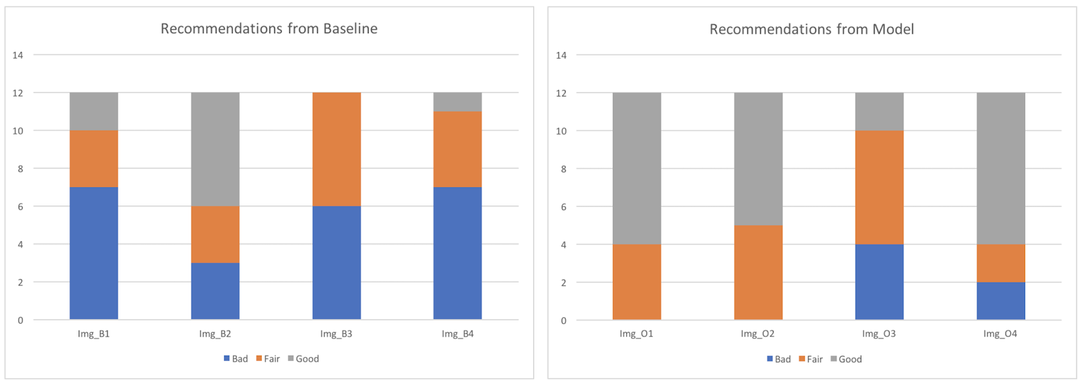
PART II - Recommending Products Based on STYLE SIMILARITY in relation to Real-World Surroundings
Comparison with Baseline Model
87.5% of the times images from our model were rated as either Good or Fair based on how relevant the recommendations were.
Whereas, only 52.083% of the times images from baseline were considered as Good or Fair on recommendations grounds.
The weighted average of the ratings for the images from our model on recommendations grounds was 1.40.
This was almost twice the weighted average of the ratings for the images obtained from baseline on recommendations grounds which was only 0.71.
Difference between Recommendations from our Model (Left) and Baseline (Right)

Slide 21
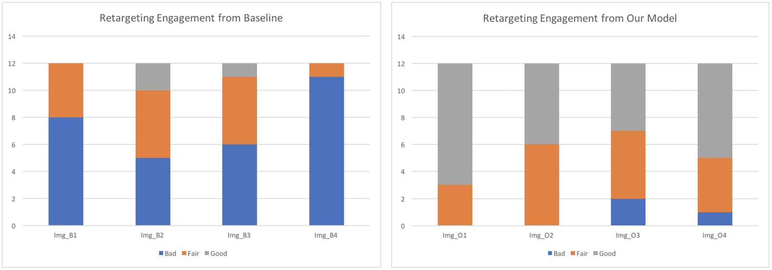
PART II - Recommending Products Based on STYLE SIMILARITY in relation to Real-World Surroundings
Comparison with Baseline Model
93.75% of the times images from our model were rated as either Good or Fair based on how engaging the images were from retargeting purposes.
Whereas, only 37.5% of the times images from baseline were considered as Good or Fair on how engaging the images were from retargeting purposes.
The weighted average of the ratings for the images from our model for retargeting purposes was 1.50.
This was more than thrice the weighted average of the ratings for the images obtained from baseline for retargeting purposes which was only 0.44.
Difference between Retargeting Engagement from our Model (Left) and Baseline (Right)

Slide 22
Conclusion
In the email marketing domain, both of the above mentioned use cases will make retargeting much more personalized and engaging which can increase conversions.
The proposed technology would fit in well with the strategic roadmap of Adobe for being a prominent player in the field of “Augmented Reality for Marketing”.

